Slide 1
Course Introduction Big Data Engineering in the Cloud
Julie Weeds
March 2020

Slide 2
Introduction
Aims
Pre-requisites
Contents
Objectives
Resources
Rules of Engagement
Introductions

Slide 3
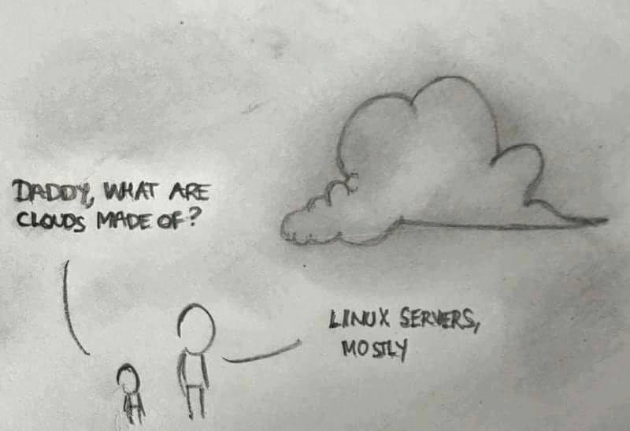

Slide 4
Big Data learning objectives
Principles
Theoretical background and origins
Practical experience of modern big data processing systems technologies
Architecture and design
Wider context

Slide 5
Pre-requisites
Covered by the Pre-Study Guide
Command line tooling and Unix commands
Some Python programming and text editors

Slide 6
Format
A mixture of lectures and practical labs
Lectures aim to provide the wider context and background
Independent of specific technologies
Labs are based on specific technologies
Designed to demonstrate the principles

Slide 7
Lab model
Local Machine
Anaconda distribution of Python
Other big data software
E.g. Apache Spark, Cassandra
Amazon Web Services
Virtual machines in the cloud

Slide 8
Contents
Big Data motivation and overview
Using Python for Data Analysis
Map Reduce and Directed Acyclic Graphs
Apache Spark
Spark and SQL
Theory of scaling
Running Spark on Amazon
Introduction to NoSQL databases
Introduction to Machine Learning

Slide 9
Practicals
Python Data Analysis
Spark, SparkSQL
Spark on Amazon
Cassandra and NoSQL
Machine Learning libraries
Visualisation

Slide 10
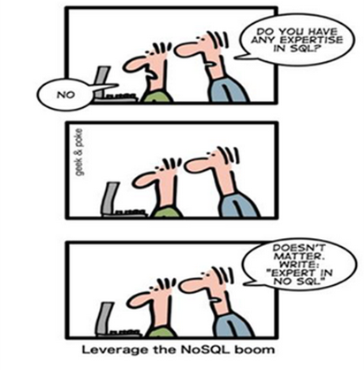
Improve your CV?

Slide 11
Beyond the scope of this course
Detailed Data Science techniques
Understanding all of Hadoop, Spark, HDFS, Machine Learning

Slide 12
Rules of Engagement
Ask questions as we go along
We will “park” any that are better answered later
Don’t wait till the end to ask or raise concerns
If you don’t ask we can’t help you

Slide 13

There might will be bugs!
Please help out:
Please create new issues on the Github repository
https://github.com/julieweeds/BigData/issues/

Slide 14
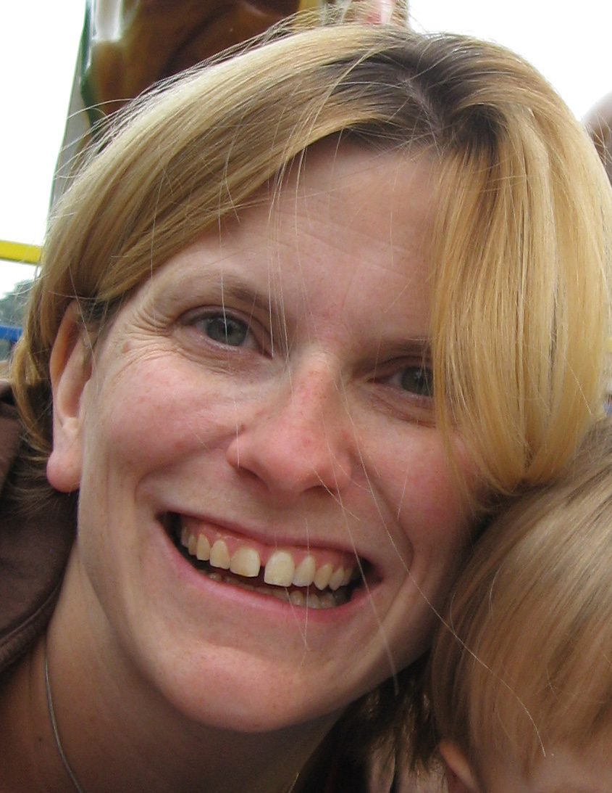
Julie Weeds
Academic qualifications:
MA(Hons) in Computer Science, Cambridge 1998
MPhil in Computer Speech and Language Processing, Cambridge 2000
DPhil in Computer Science (Natural Language Processing), Sussex 2003
PGCE in Mathematics teaching, Brighton 2006
Experience
NLP researcher (2000-2005, 2012-)
Experienced python programmer
Data Science Lecturer, Sussex 2016 -

Slide 15
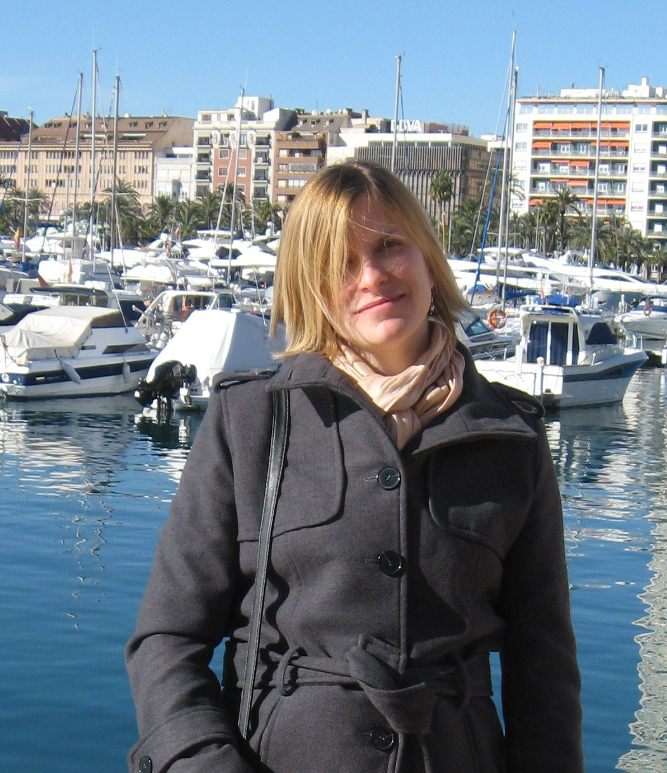
Julie Weeds

Slide 16
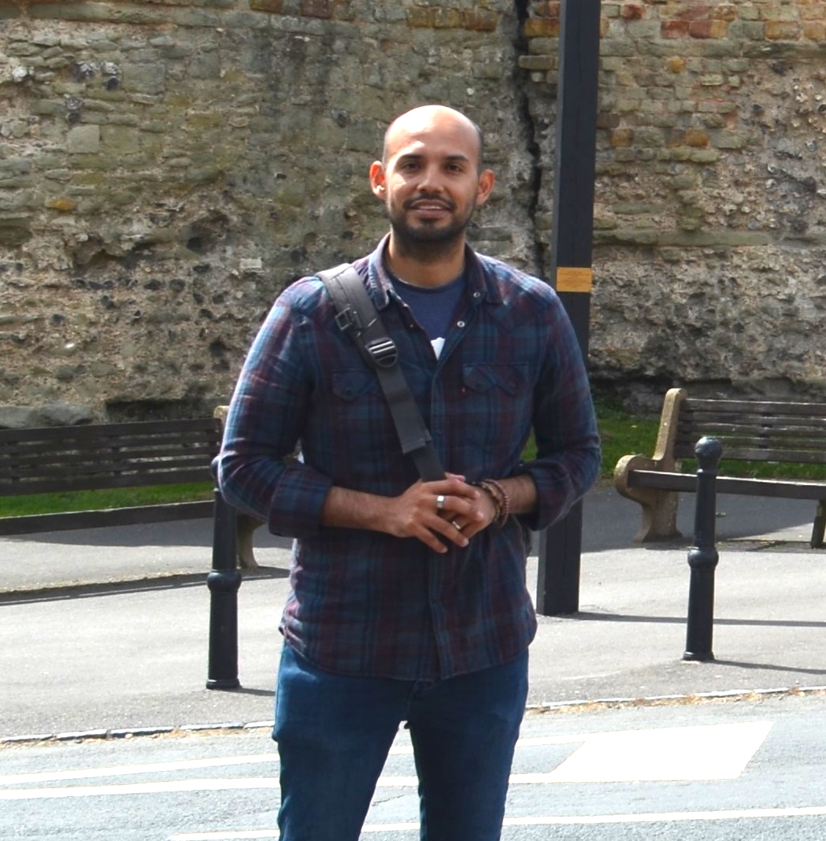
Nestor Prieto

Slide 17

Simon Wibberley

Slide 18
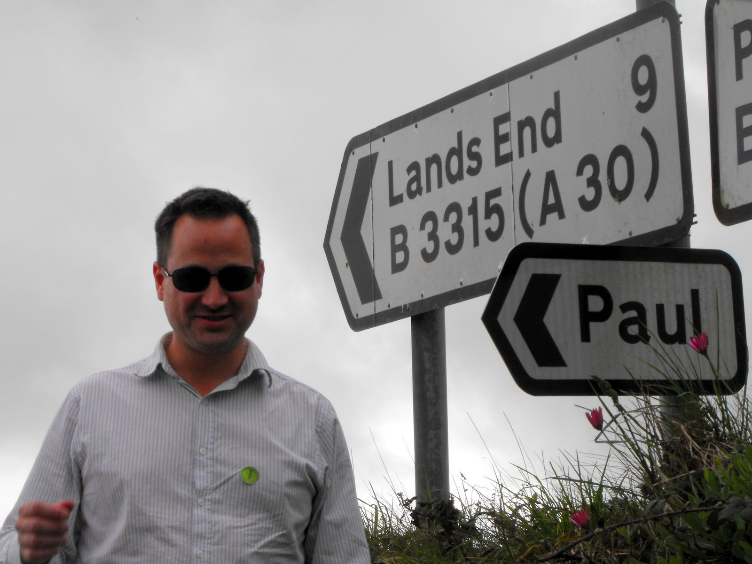
Paul Fremantle
CTO and Co-Founder of WSO2
Previously Senior Technical Staff Member, IBM WebSphere architecture
Visiting Lecturer, Oxford University
VP, Apache Synapse and Member of Apache
PhD in Computing (2017)
IoT security and privacy

Slide 19

David Johnson
Senior Researcher, e-Science, Oxford University
Founding Member, Data Science Institute, Imperial
PhD, Reading University, 2010
Awarded University of Oxford Teaching Award, 2016

Slide 20
You?

Slide 21
Approximate Schedule
Monday
Introductions
Overview and Motivation
Data Analysis with Python and Pandas
Map Reduce
Apache Spark
Tuesday
SQL
Theoretical background on scaling systems
Scaling Spark on AWS
Visualisation
Wednesday
Introduction to Machine Learning
Realtime systems
Architecting big data systems
Completion of labs

Slide 22

Let’s get started

